Slide 1
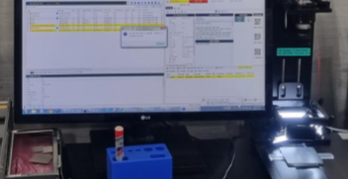
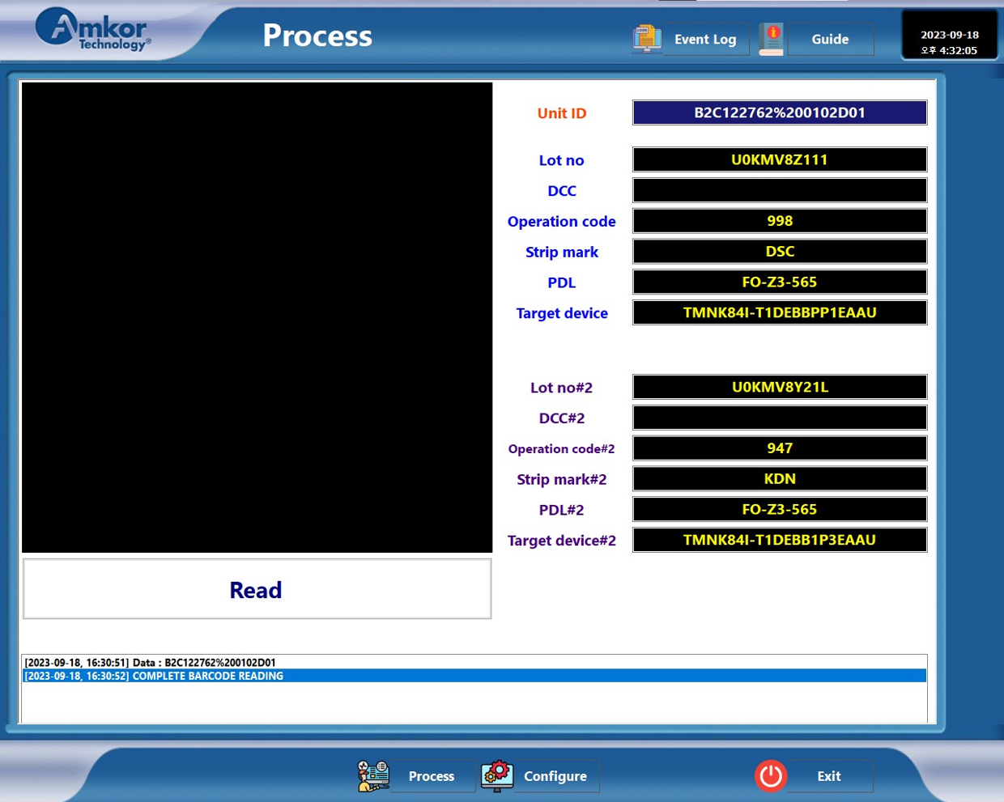
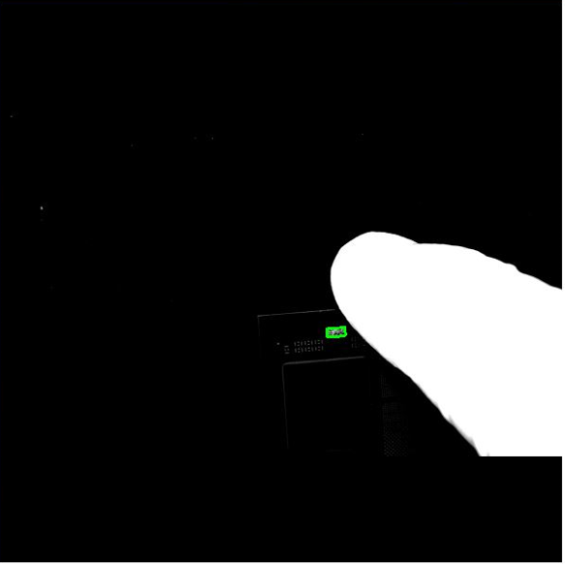
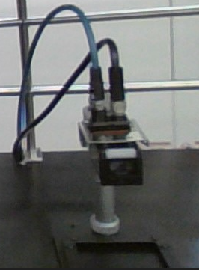
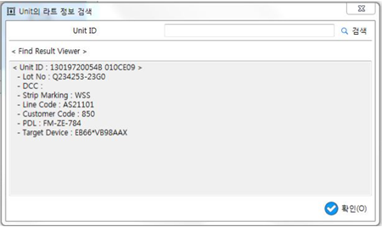
Weekly EED Activity – WW38
K5 / 2T 2P
FCBGA / All
New
K5 FCBGA, L/M Lid 2D marking reading system development
MFG / EED
NA
N/A
[Problem Description]
[Action taken]
Vendor machine
No reader live view function
Only show Unit ID
Search lot no, mark information in WIP
2DID reading system
Live view function
No need for manual search in WIP
Show Lot no, DCC, Mark, P/D/L information
Displays 2types of Lot information
Vendor machine
Manual search
UI
Barcode kit
Method : Only show 2DID / Manual search (Lot information)
Method : Show 2types of Lot no / No need for manual search
Cost save : outsourcing: 24K, in house 3.4K
Work efficiency improvement
HyunSu Park, ChulKyu Lee(YoungHo Kim) / ww38 `23 K5EE

